Slide 1
Numerikus módszerek
Zh algoritmusai
Dr. Hegedűs Csaba gyakorlatai alapján készítette: Szabó Dániel

Slide 2
LU-felbontás (A=LU, ahol L alsó, U felső háromszögmátrix)
2 | 0 | 3 | -1
-4 | 5 | -2 | 3
6 | -5 | 4 | -3
2 | 0 | 3 | -1
-2 | 5
3
2 | 0 | 3 | -1
-2 | 5 | 4
3
A=
 | = | 5 | - | ( | -2 | * | 0 | )
 | = | -2 | - | ( | -2 | * | 3 | )
osztás iránya
2 | 0 | 3 | -1
-2 | 5 | 4 | 1
3 | -5 | -5 | 0
2 | 0 | 3 | -1
-2 | 5 | 4 | 1
3 | -1 | -1
2 | 0 | 3 | -1
-2 | 5 | 4 | 1
3 | -1 | -1 | 1

Slide 3
2 | 0 | 3 | -1
-2 | 5 | 4 | 1
3 | -1 | -1 | 1
1
-2 | 1
3 | -1 | 1
L=
x₁ | x₂ | x₃
2 | 0 | 3
 | 5 | 4
 |  | -1
-1
1
1
x₁ = 1
Ux= =
x₂ = 1
2 | 0 | 3
 | 5 | 4
 |  | -1
x₃ = -1
1
-2 | 1
3 | -1 | 1
2 | 0 | 3
-4 | 5 | -2
6 | -5 | 4
Ell.: A=LU

Slide 4
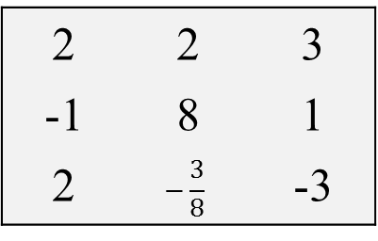
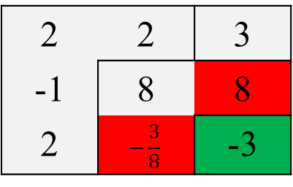
LDU-felbontás (A=LDU, ahol L alsó, U felső háromszögmátrix, D diagonális mátrix)
2 | 4 | 6
-2 | 4 | 2
4 | 5 | 6
2 | 4 | 6
-1 | 8
2
2 | 2 | 3
-1 | 8 | 8
2 | -3 | -6
A=
osztás iránya
 | = | 4 | - | ( | -1 | * | 4 | )
2 | 2 | 3
-1 | 8 | 8
2 | -3 | -6
2 | 2 | 3
-1 | 8 | 8
2 | $$−\frac{3}{8}$$ | -3
2 | 2 | 3
-1 | 8 | 1
2 | $$−\frac{3}{8}$$ | -3

Slide 5
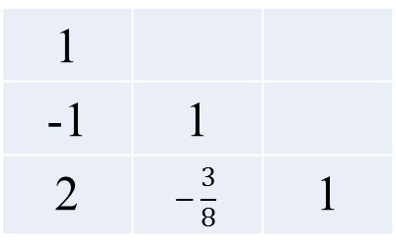
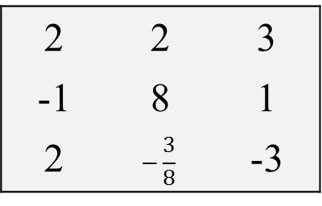
2 | 2 | 3
-1 | 8 | 1
2 | $$−\frac{3}{8}$$ | -3
1
-1 | 1
2 | $$−\frac{3}{8}$$ | 1
L=
2
 | 8
 |  | -3
D=
1 | 2 | 3
 | 1 | 1
 |  | 1
U=

Slide 6
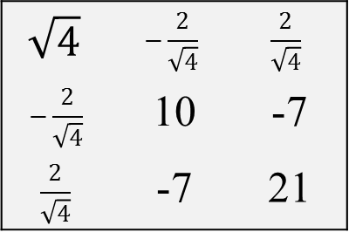
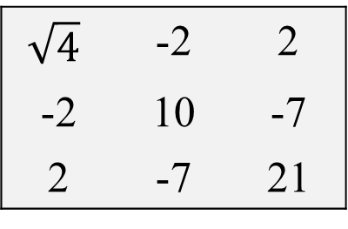
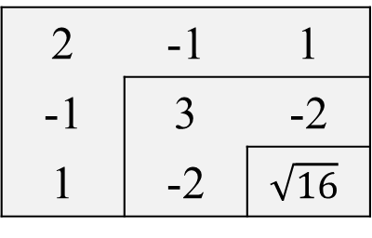
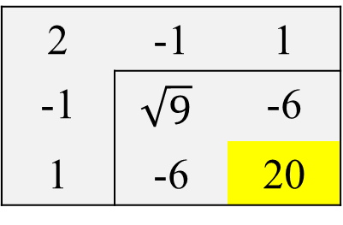
Cholesky-felbontás (A=LL^{T})
4 | -2 | 2
-2 | 10 | -7
2 | -7 | 21
$$\sqrt{4}$$ | -2 | 2
-2 | 10 | -7
2 | -7 | 21
$$\sqrt{4}$$ | $$−\frac{2}{\sqrt{4}}$$ | $$\frac{2}{\sqrt{4}}$$
$$−\frac{2}{\sqrt{4}}$$ | 10 | -7
$$\frac{2}{\sqrt{4}}$$ | -7 | 21
A=
2 | -1 | 1
-1 | 10 | -7
1 | -7 | 21
2 | -1 | 1
-1 | 9
1
2 | -1 | 1
-1 | 9 | -6
1 | -6 | 20
2 | -1 | 1
-1 | $$\sqrt{9}$$ | -6
1 | -6 | 20
2 | -1 | 1
-1 | 3 | -2
1 | -2 | 16
2 | -1 | 1
-1 | 3 | -2
1 | -2 | $$\sqrt{16}$$
!!!

Slide 7
2 | -1 | 1
-1 | 3 | -2
1 | -2 | 4
// A mátrix elemei szimmetrikusak a főátlóra (ellenőrzéshez alap)
2
-1 | 3
1 | -2 | 4
2 | -1 | 1
 | 3 | -2
 |  | 4
L=
L^{T}=
2 | -1 | 1
 | 3 | -2
 |  | 4
Ell.: A=L L^{T}
2
-1 | 3
1 | -2 | 4
4 | -2 | 2
-2 | 10 | -7
2 | -7 | 21

Slide 8
QR-felbontás (A=QR, ahol Q ortogonális (QQ^{T}=I), R felső háromszögmátrix)
2 | 6 | 5
-1 | -4 | 1
-1 | -2 | -3
6
2 | 6 | 5
-1 | -4 | 1
-1 | -2 | -3
6 | 18
A=
 | = | 2 | * | 2 | + | -1 | * | -1 | + | -1 | * | -1
 | = | 2 | * | 6 | + | -1 | * | -4 | + | -1 | * | -2
2 | 6 | 5
-1 | -4 | 1
-1 | -2 | -3
6 | 18 | 12
 | = | 2 | * | 5 | + | -1 | * | 1 | + | -1 | * | -3

Slide 9
2 | 6 | 5
-1 | -4 | 1
-1 | -2 | -3
6 | 18 | 12
1 | 3 | 2
2 | 6 | 5
-1 | -4 | 1
-1 | -2 | -3
6 | 18 | 12
1 | 3 | 2
0
-1
1
 | = |  | - |  | *
0 | 1
-1 | 3
1 | -1
0 | 1
-1 | 3
1 | -1
0 | 1
-1 | 3
1 | -1
2 | -4
1 | -2
1
1
1
1
 | = |  | - |  | *
 | = |  | - |  | *

Slide 10
2 | 6 | 5
-1 | -4 | 1
-1 | -2 | -3
2 | 6 | 5
-1 | -4 | 1
-1 | -2 | -3
6 | 18 | 12
1 | 3 | 2
0 | 1
-1 | 3
1 | -1
2 | -4
1 | -2
1
1
1
1
2 | 0 | 1
-1 | -1 | 1
-1 | 1 | 1
Q=
1 | 3 | 2
 | 1 | -2
 |  | 1
R=
1 | 3 | 2
 | 1 | -2
 |  | 1
Ell.: A=QR
2 | 0 | 1
-1 | -1 | 1
-1 | 1 | 1
2 | 6 | 5
-1 | -4 | 1
-1 | -2 | 1

